Slide 1
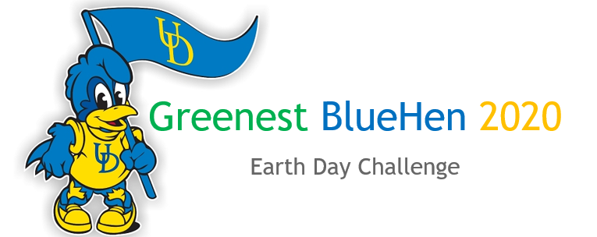
2021
“Restoring our earth through creative communications & actions”
SUBMIT ENTRIES BEFORE APRIL 16, 2021: www.udel.edu/008250
Over $2,000 in cash prizes
With generous support from DENIN & UD Sustainability Council

Slide 2
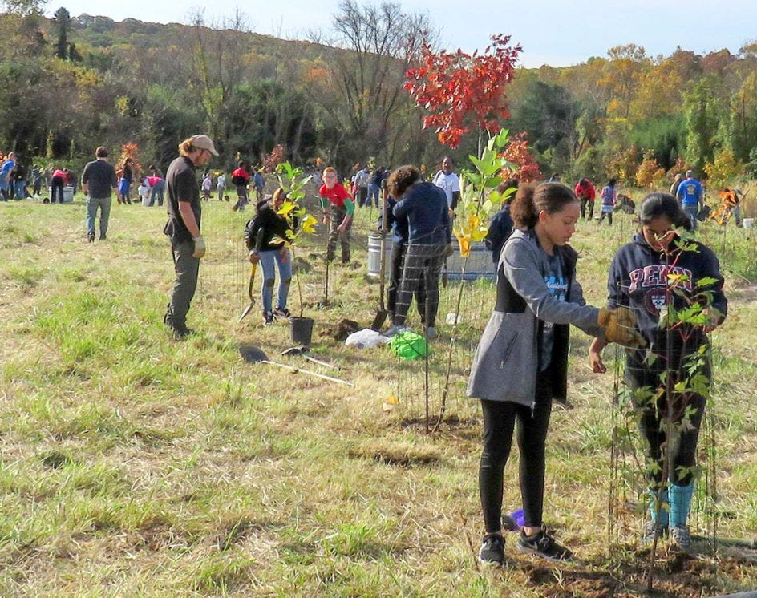
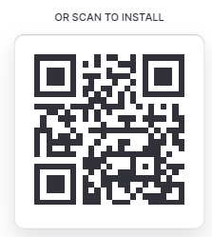
Key Planned activities:
Total of 100 points possible
50 points
Climate communication challenge
50 points
White Clay Creek Park adoption/invasive species removal – we are in discussions with DNREC to adopt of a section of the park (for ongoing maintenance and removal of invasive species with support from DNREC team).
Clean-up: Scheduled for Apr 10, 2021 (9am -12pm) – we shall undertake clean up in WCCSP along the Pomeroy Trail; registration www.udel.edu/008282
iNaturalist competition – identify as many species as possible using iNaturalist – this helps in ongoing invasive species removal efforts https://www.inaturalist.org/projects/gbh2021
All activities registered in Greenest Blue Hen App - https://gbh2021.glideapp.io/
Earth Day Celebrations: Panel discussions and awards event.
Participating in all activities earns you points towards winning the awards and prizes.

Slide 3
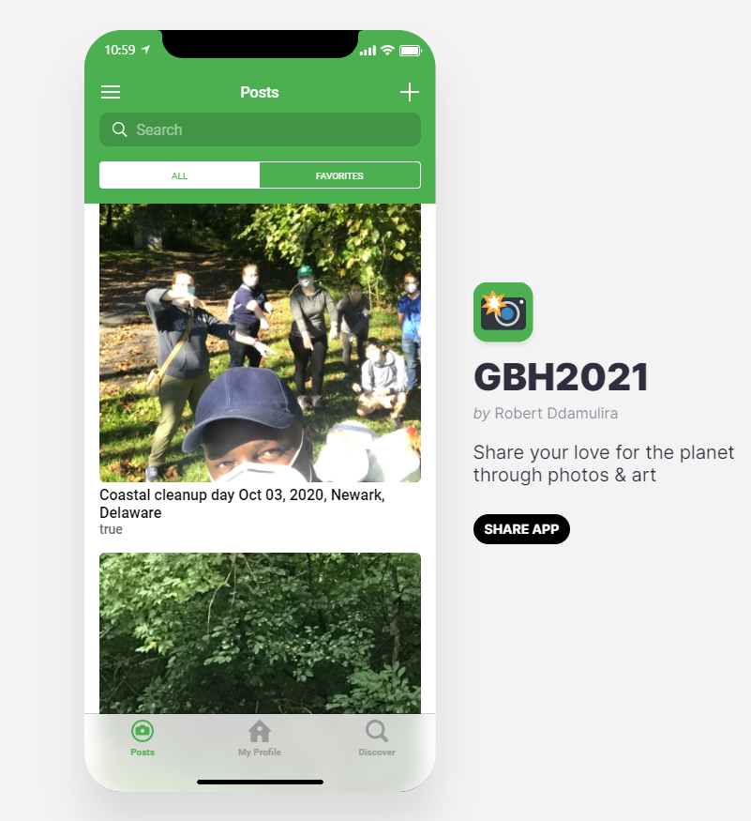
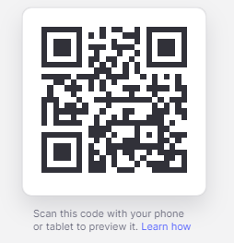

Slide 4
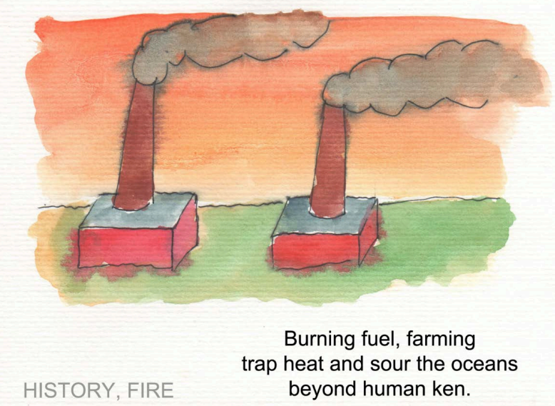
Creatives Challenge: Communicating Climate Solutions
Theme: Restoring our earth through creative communications
Eligible: Grad, undergrad, postgrad creatives at University of Delaware & beyond.
Entries allowed:
Traditional art (painting, cloth art etc)
Digital visual media (e.g. video/photograph)
Digital audio media (poem recital)
Notes:
Focused on creative communications of climate solutions
Climate science is well established however it has not yet effectively driven the required levels of public policy change, neither has it radically transformed our individual behaviors and choices.
We are inviting student creatives at University of Delaware & beyond.
We invite all creative grad & undergrad students to use their imaginations to illustrate their concerns and solutions through art which can be digitally shared to communicate climate change across the three themes; energy, food and climate justice.
The digital art pieces may include; artistic drawings, songs, videos

Slide 5
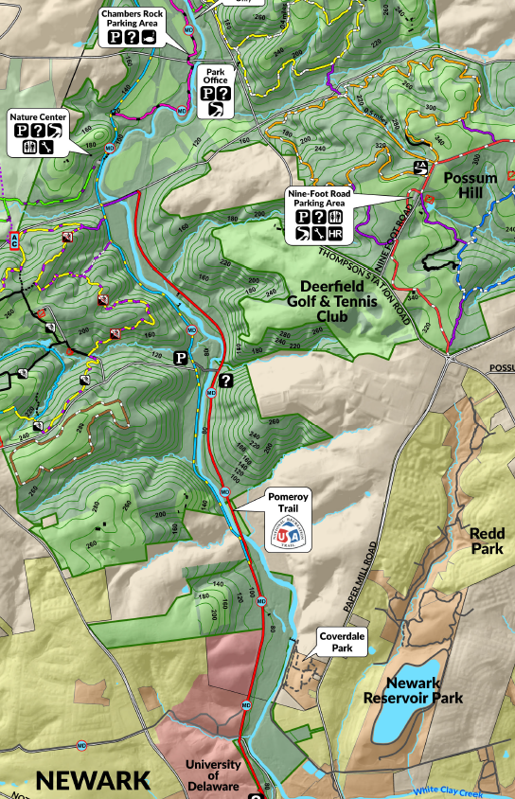
White Clay Creek State Park
potential invasive plant removal areas
Proximity to campus, parking, and ease of access are all things to consider.
1. Mckay Jenkins has a toolbox with all necessary equipment in the woods at this location; we can reach out to him to confirm it is still there, and if he would like to join with his Environmental Humanities class
2. Another potential location with old forest growth and parking along Creek Rd. or Wedgewood Rd. parking lot
3. Nature Center has ample parking and work was recently done there (with the goats!)
3
Nature center parking lot
2
1
Notes:
I overlaid part of the park map as best as I could to see park boundaries, trails, other features. You can delete or change transparency if you’d like to see satellite imagery or park map better

Slide 6
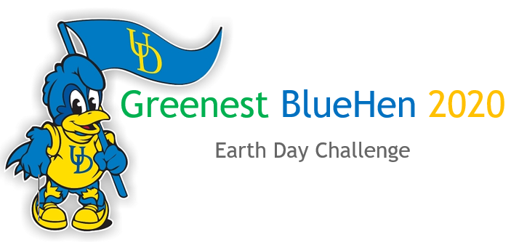
SELECTING WINNERS:
Winners will be selected by a panel of judges – including DENIN Grad fellows + members of UD Sustainability Council
This Photo by Unknown Author is licensed under CC BY

Slide 7
PRIZES
$2,000 to be split amongst top 3 UD winners
Art pieces to be displayed at DENIN website/UD Sustainability & social media
Bragging rights for one year!

Slide 8
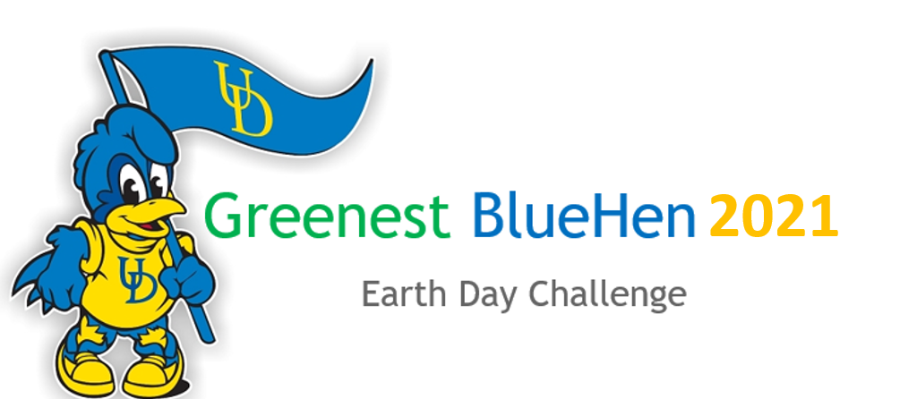
COORDINATING TEAM:
Robert Ddamulira Ph.D.
Eric Moore
Spencer Moller
Fatemeh Izaditame
Judges
Alma Lule
Danhui Xin
Joanne Norris
Jimmy Murillo (tbc)
Cara Clase (tbc)
CONTACT:
ROBERT DDAMULIRA, Ph.D.
Researcher, Center for Energy & Environment Policy (CEEP)
Biden School of Public Policy & Administration
Email: robertdd@udel.edu

